Slide 1


FACE RECOGNITION DSN-2098
Group No: 287
Guided by-
MR. GOPAL SINGH TANDEL

Slide 2





Team Members
Ansh Nagar - 21BCE10704
Harshit Dhundale - 21BCE11454
Prakhar Saxena - 21BCE11360
Mohammed khaja mohinuddin - 21BCE11595
Mohammad Aatif raza khan – 21BCE11290

Slide 3


Contents
Introduction
Existing work with Limitation
Proposed work and methodology
Novelty of the Project
Real time usage
Hardware and software requirements
Overall system architecture diagram.
Literature review
Module description and Workflow
Implementation of project.
Accuracy
Demo video
Testing
Result and Conclusion.

Slide 4




Introduction
Face recognition is defined as the science which involves the understanding of how the faces are recognized by biological systems and how this can be emulated by computer systems. It is a biometric technique to uniquely identify a person by comparing and analyzing patterns based on their "facial contours"

Slide 5



Existing work with Limitation
There are face detecting softwares present but there are two major problems: one is feature extraction and then pattern recognition. Before this image, registration of all the faces is required to enhance the recognition rate of the whole system. So these all motivates to search for a new method to solve all these problems and then integrate them to make a fully functional system with high accuracy.

Slide 6




Proposed work and methodology
To make face recognition more efficient, we are introducing a high accuracy system which detects face and generates the name of the person. This system will be convenient for
several tasks such as marking attendance of students in a class.

Slide 7
Novelty of project
Support and accelerate investigations
Identify and track criminals
Find missing children and disoriented adults
Use of facial recognition for online KYC

Slide 8



Real time usage
Face recognition technology can be applied to various fields -- including security, biometrics, law enforcement, entertainment and personal safety -- to provide surveillance and tracking of people in real time.

Slide 9



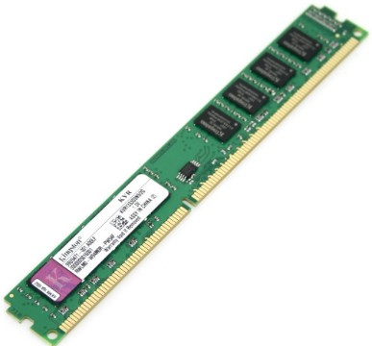
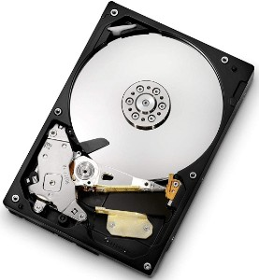
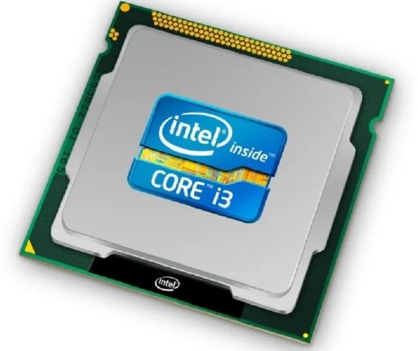


Hardware and software requirment
Hardware
8GB RAM
4 core processor
256GB HDD

Slide 10






Software
LIBRARIES
cv2 – 4.5.2
numpy – 1.20.3
face_recognition – 1.3.0
dlib

Slide 11



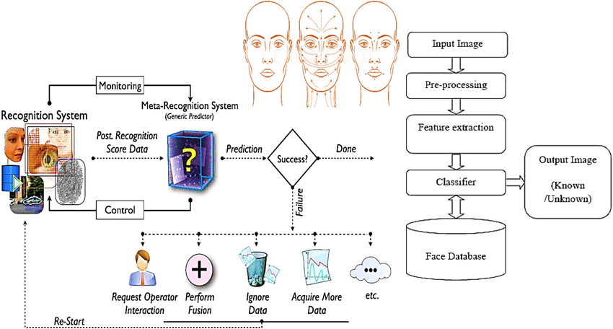
Overall system architecture diagram

Slide 12


Literature review:
In an experiment with ear and face recognition, using the standard principal component analysis approach , showed that the recognition performance is essentially identical using ear images or face images and combining the two for multimodal recognition results in a statistically significant performance improvement. For example, the difference in the rank-one recognition rate for the day variation experiment using the 197-image training sets is 90.9% for the multimodal biometric versus 71.6% for the ear and 70.5% for the face.
There is substantial related work in multimodal biometrics.
Use of the face and ear in combination seems more
relevant to surveillance applications.

Slide 13


Module description and Workflow:
1. Prepare the dataset
Create 2 directories, train and test. Pick an image for each of the cast from the internet and download it onto our “train” directory.
We have to make sure that the images we’ve selected show the features of the face well enough for the classifier.

Slide 14





2. Train the model
for x in os.listdir(path):
image = fr.load_image_file(path + x)
image_path = path + x
encoding = fr.face_encodings(image)[0]
known_name_encodings.append(encoding)
known_names.append(os.path.splitext(os.path.basename(image_path))[0].capitalize())

Slide 15


3. Test the model on the test dataset
file_path = input("Enter the File Path of the Test Image:" )
lenght = len(file_path)
test_image = file_path[1:lenght-1]

Slide 16
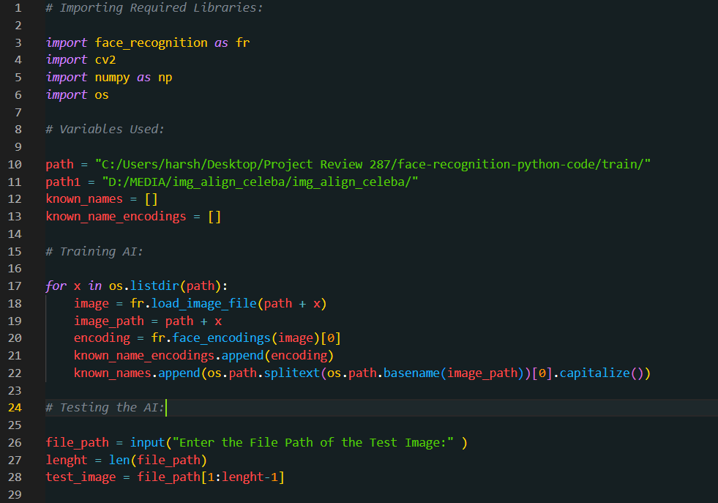
Implementation Snapshots

Slide 17
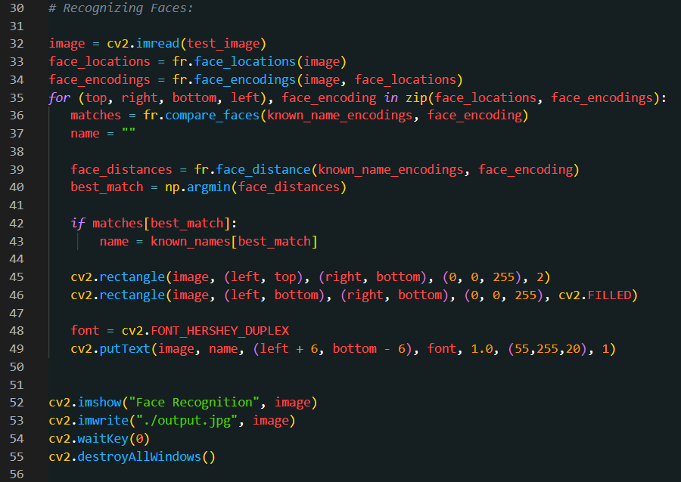

Slide 18
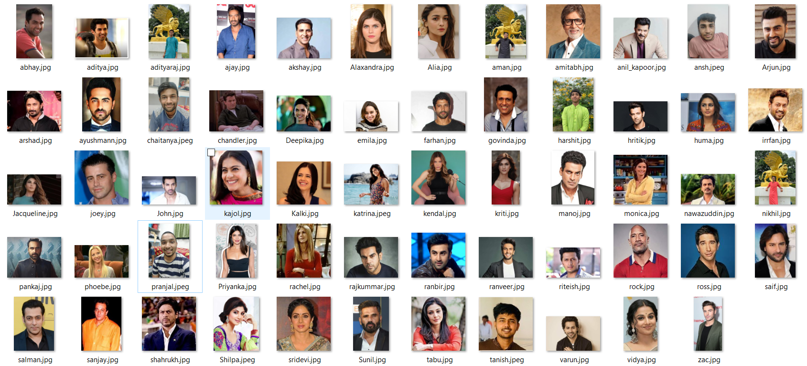
TRAIN
60 images used (more can be increased as per requirement)

Slide 19

TEST

Slide 20
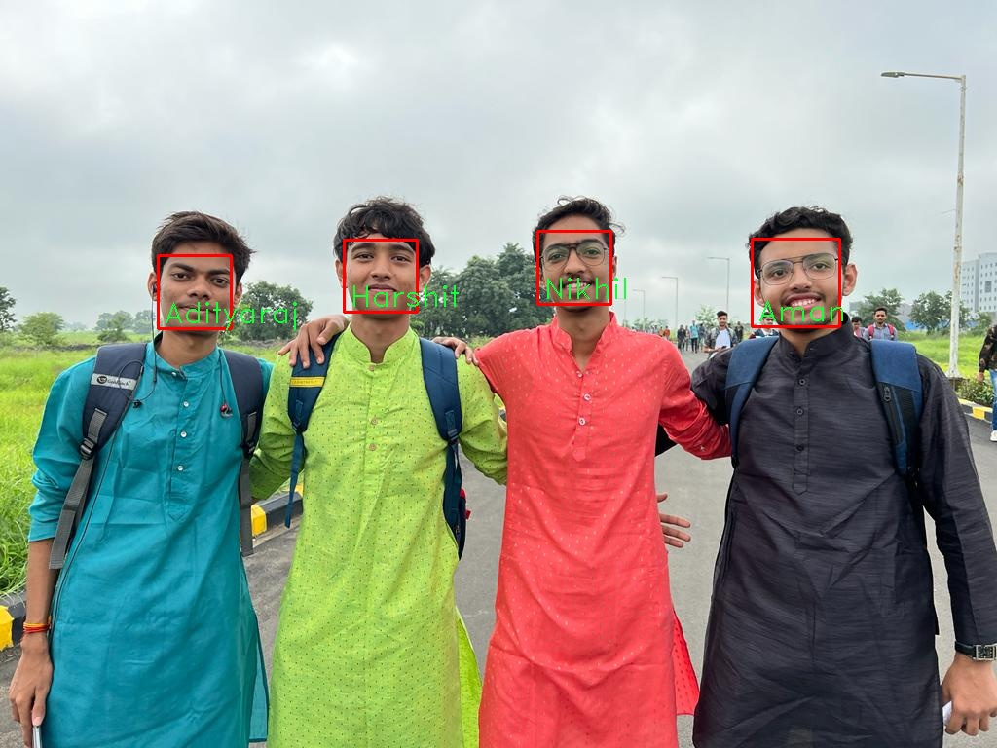
Outputs

Slide 21
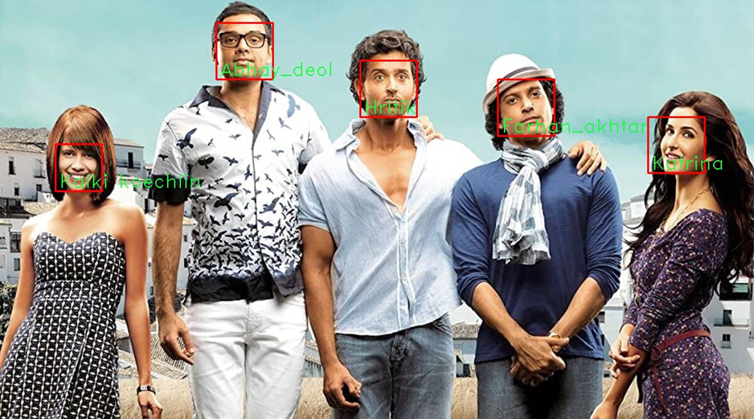

Slide 22
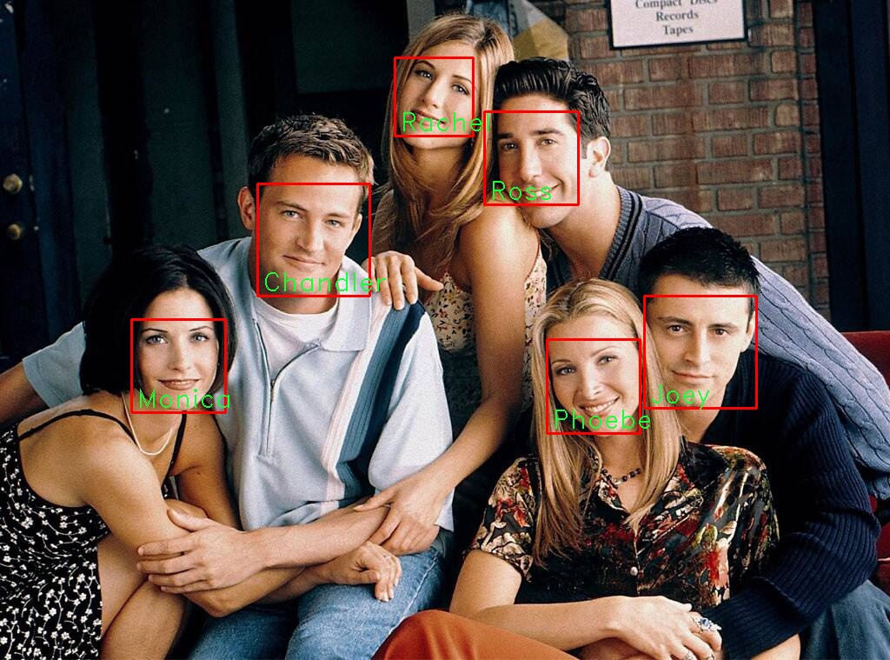

Slide 23
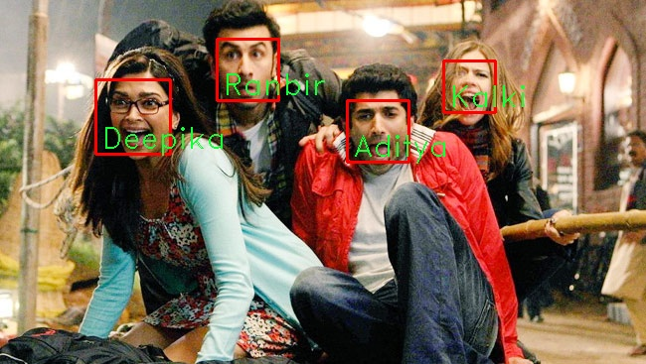

Slide 24
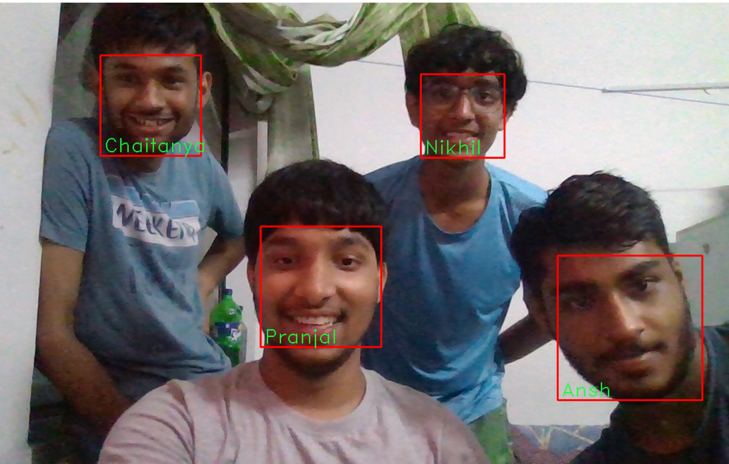

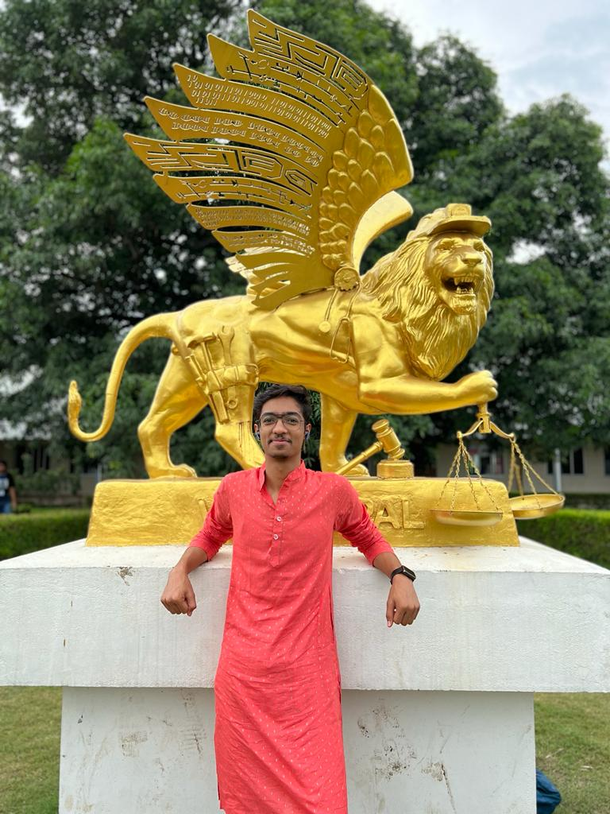
Harshit
Nikhil
In this output, we get an error due to the low quality of image.
The person recognised as Nikhil is actually Harshit.

Slide 25
ACCURACY
The accuracy observed in the program is 96% as out of 25 test images, in 24 images face was recognised correctly.

Slide 26

Demo Video

Slide 27





Testing:
System 1 : Ryzen 7 16 core CPU and RTX 3050 GPU
The program is working as intended.
No error and bugs were found.
Execution time was fast.
System 2: Ryzen 5 8 core CPU GTX 1650 GPU
The program is working as intended.
No error and bugs were found.
Execution time was moderate.
System 3: Intel i5 11th gen 8 core CPU and intel iris xe GPU
The program is working as intended.
No error and bugs were found.
Execution time was moderate.

Slide 28
IV. System 4: Intel i7 11th gen 12 core CPU and RTX 3050 GPU
The program is working as intended.
No error and bugs were found.
Execution time was moderate.
V. System 5: Intel i9 11th gen 16 core CPU and RTX 3090ti GPU
The program is working as intended.
No error and bugs were found.
Execution time was fast.
VI. System 6: Intel pentium gold and no GPU
The program is working as intended.
No error and bugs were found.
Execution time was very slow.

Slide 29
Conclusion:
In this machine learning project, we developed a face recognition model in python which also generates names on detecting the face using our own custom dataset.

Slide 30


Thank You

